Slide 1
Revolutionizing Hydration: The Power of Smart Water Fountains
By –
P. Balaguru
U. Mangleshwar
S. Selvakumar
J. MOHAN
A. ArundOss

Slide 2
Content
Introduction The Problem The Solution Features Benefits Implementation Costs Challenges Future Conclusion

Slide 3

Introduction
Welcome to the world of tomorrow, where technology meets sustainability in the form of smart water fountains. These innovative fountains represent a new era in hydration, providing a solution to the environmental crisis caused by plastic waste. Imagine a future where every public space is equipped with a smart water fountain that not only quenches your thirst but also tracks your water consumption and provides real-time data on your hydration levels. With these fountains, we can reduce plastic waste and promote healthy habits for generations to come.

Slide 4

Problems
Plastic waste is one of the biggest environmental challenges facing our planet today. Every year, over 8 million tons of plastic end up in the world’s oceans, harming marine life and polluting our waterways. In fact, by 2050, there will be more plastic in the ocean than fish if we don’t take action now. But the problem isn’t just limited to our oceans. Plastic waste also harms wildlife on land, as well as contributing to air pollution when it’s burned or left to decompose in landfill sites. And with plastic taking hundreds of years to break down, the problem is only getting worse.

Slide 5
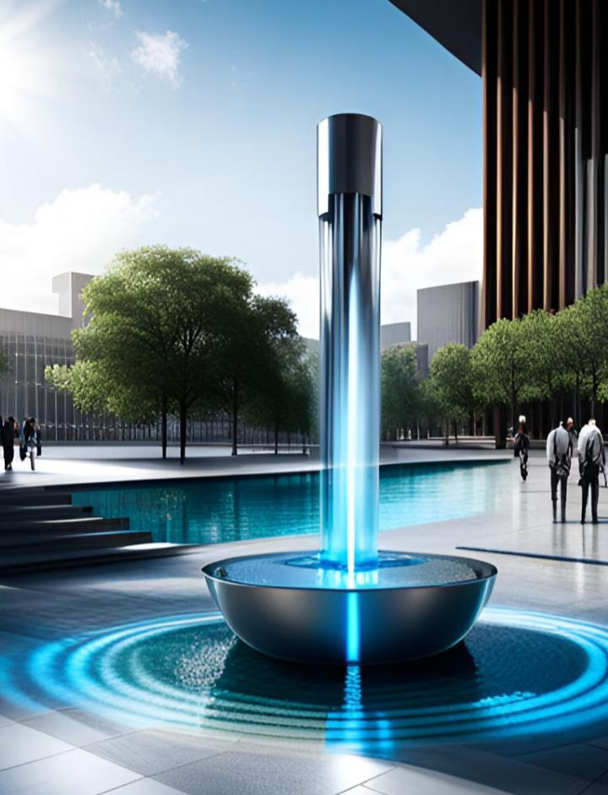
Solutions
Smart water fountains are an innovative solution to the problem of plastic waste. These fountains are designed to be eco-friendly and sustainable, providing a reliable source of clean drinking water without the need for disposable plastic bottles. They work by filtering tap water and dispensing it into reusable containers, such as refillable water bottles or cups. In addition to reducing plastic waste, smart water fountains offer a range of benefits. For example, they promote hydration and encourage people to drink more water throughout the day. They also provide real-time data on water consumption, allowing users to track their intake and make informed decisions about their health and well-being. By implementing smart water fountains in public spaces, we can create a more sustainable and healthy environment for everyone.

Slide 6

Features
One of the key features of smart water fountains is their ability to track water consumption and provide real-time data. This means that users can easily monitor how much water they are consuming, and adjust their habits accordingly. The fountains also have sensors that detect when a bottle or cup is being filled, which allows for accurate tracking of water usage. Another important feature of smart water fountains is their ability to provide real-time data about water quality. This ensures that users can be confident in the safety and cleanliness of the water they are drinking. In addition, many smart water fountains have built-in filtration systems that remove impurities and contaminants from the water.

Slide 7

Benefits
Smart water fountains are a game-changer in the fight against plastic waste. By providing a convenient and eco-friendly alternative to bottled water, these fountains can help reduce the amount of plastic that ends up in our landfills and oceans. In addition to their environmental benefits, smart water fountains also promote hydration and better health. With features like real-time data tracking and personalized recommendations, these fountains make it easier than ever to stay hydrated throughout the day.

Slide 8

Implementation
Smart water fountains can be implemented in public spaces, such as parks and schools, to provide access to clean drinking water without the need for single-use plastic bottles. Successful implementations of these fountains have been seen in cities across the world, including London, Paris, and San Francisco. In London, smart water fountains were installed in popular tourist areas, such as Oxford Circus and Piccadilly Circus, to encourage visitors to stay hydrated and reduce their plastic waste. Similarly, in Paris, smart water fountains were installed in public parks and gardens to provide residents with easy access to clean drinking water. And in San Francisco, the city has launched a program to install 100 smart water fountains throughout the city by 2022.

Slide 9

Costs
Implementing smart water fountains can come with significant costs, but the benefits they provide make them a worthwhile investment. The initial cost of installing a smart water fountain can range from $3,000 to $10,000 depending on the size and features of the fountain. However, this cost can be offset by the savings that come from reduced plastic waste and lower water bills. In addition to installation costs, there are also ongoing maintenance costs to consider. Smart water fountains require regular cleaning and upkeep to ensure that they function properly. This can include replacing filters, monitoring water quality, and repairing any malfunctions. While these costs can add up over time, they are essential to ensuring that the fountain continues to provide clean and safe drinking water.

Slide 10

Challenges
One of the main challenges associated with implementing smart water fountains is funding. While the benefits of these fountains are clear, the cost of installation and maintenance can be a barrier for many organizations. However, there are potential solutions to this challenge. For example, partnerships with local businesses or community organizations could help fund the installation of smart water fountains in public spaces. Another challenge is public perception. Some people may be resistant to change or skeptical of new technology. To address this challenge, it’s important to educate the public about the benefits of smart water fountains and provide them with an opportunity to try them out. This could involve setting up demonstration stations in public spaces or partnering with schools to promote the use of smart water fountains among students.

Slide 11

Future
The future of smart water fountains is exciting and full of potential. With advancements in technology, we can expect to see even more innovative features that will revolutionize the way we think about hydration. Imagine a world where smart water fountains not only track your water consumption but also provide personalized recommendations based on your individual needs. This could have a significant impact on public health, as it would encourage people to drink more water and stay hydrated. Smart water fountains also have the potential to make a significant impact on the environment. By reducing the need for single-use plastic bottles, we can significantly reduce plastic waste and help protect our oceans and wildlife. As more cities and public spaces adopt smart water fountains, we can work towards a more sustainable future for generations to come.

Slide 12

Conclusion
In conclusion, smart water fountains are a crucial solution to the problem of plastic waste and promoting hydration. By tracking water consumption and providing real-time data, they not only benefit the environment but also public health. Implementing smart water fountains in public spaces such as parks and schools can have a significant impact on reducing plastic waste and promoting sustainability. However, the challenges associated with implementation, such as funding and public perception, must be addressed. It’s important for individuals and organizations to support the implementation of smart water fountains by advocating for their installation in public spaces and investing in their maintenance. Together, we can make a difference and create a more sustainable future.

Slide 13
Thank you!

